Slide 1
Capstone Project - The Battle of Neighborhoods
Prashanth H Siddaraju

Slide 2
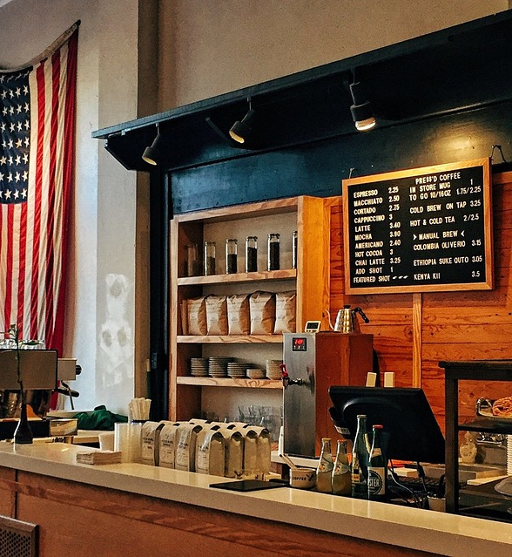
Problem Description
If any coffee company or a coffeehouse chain is planning to open a new store in New York or Toronto, where can they open the same?
Which are the probable Neighborhoods in which coffee is already being sold by a non-Coffee store, but have a possibility to have a coffee store?
Which coffee drinking neighborhoods in New York and Toronto are similar, so the same business model can be implemented in the other city as well?

Slide 3

Some Statistics to Start with
58% of Americans over the age of 18 drink coffee every single day
The US alone spends $4 billion importing coffee each year
The average coffee drinker spends $164.71 on coffee each year
100 million people in the US drink coffee each day
25% of Americans skip breakfast, yet 50% will still consume a cup of coffee in the morning
Specialty coffee sales are increasing by 20% per year and account for nearly 8% of the 18 billion-dollar U.S. coffee market.

Slide 4
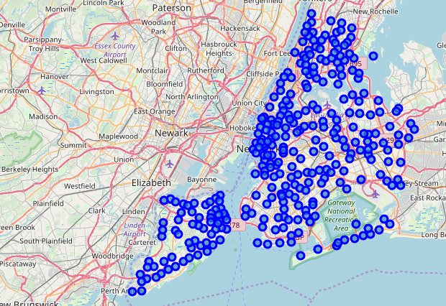
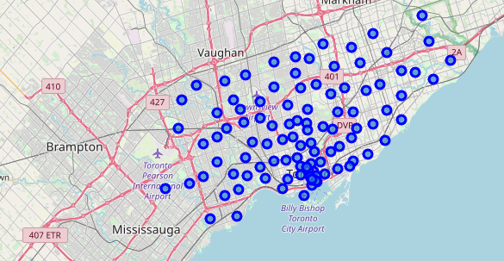
New York and Toronto Neighborhoods
New York
Toronto

Slide 5
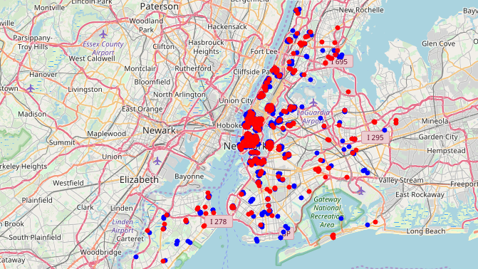
New York Coffee vs Non-Coffee Shops
Here in the Picture Red represents Non-Coffee Shops selling coffee, and Blue represents Main stream coffee shops.
On Close Inspection we can see that there are few places where Non-Coffee shops are in more number, which would mean the demand for coffee is high. This would also imply , it would be great location for main stream coffee shops to open

Slide 6
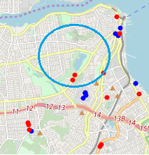
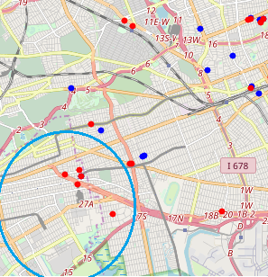
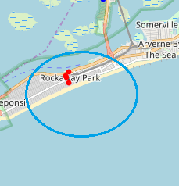
New York Coffee vs Non-Coffee Shops - Continued
Few examples where the coffee shops can be opened based on inference from the clustering.

Slide 7

Similar Neighborhoods in New York and Toronto
For this problem, we had to first cluster the neighborhoods of New York and Toronto together to check which neighborhoods are more similar.
Based on the clusters we can decide weather the same business model works in similar cities.
Note: Here we are not taking economic factors and population into consideration. It has to be considered for the model to be accurate.
We can consider 4 Clusters to start with, and use KMeans Clustering approach to solve this problem.

Slide 8




Similar Neighborhood clusters
Here we can notice that , Clusters 1, 2 and 3 have similar neighborhoods in New York and Toronto, but Cluster 4 has only New York Neighborhoods
Cluster 4 Neighborhoods are not similar to any neighborhood in Toronto.

Slide 9
Conclusion
There are similar neighborhoods in New York and Toronto based on demand for Coffee shops in both the cities, which would help business to build better profit models.
By looking at the distribution of coffee and non-coffee shops , and clustering the same, we were able to make decisions on probable places for opening main stream coffee shops.

Slide 10


